Slide 1
Contribution to Camara commonalities workgroup meeting TMF open API
Ludovic Robert
Orange

Slide 2
objective & caveat
why this initiative?
Orange operates TM Forum open API in lot of context with effective result
Orange is TM Forum contributor and TMF API manifesto signatories (TMF Manifesto) as Deutsche Telekom, Vodafone, Telefonica, etc..
as such, Orange commitment is to utilize these APIs whenever appropriate in establishing new digital partnerships
→ objective: Do the Open TMF API are appropriate in Camara context ?
how to start?
from Camara document “API Backlog” listing API family identify potential TMF API candidate
this is only a first draft that need to be challenged/completed
important caveat:
this document is an Orange contribution. It has not been reviewed by the TM Forum and as such it is not a TMF endorsed document.

Slide 3

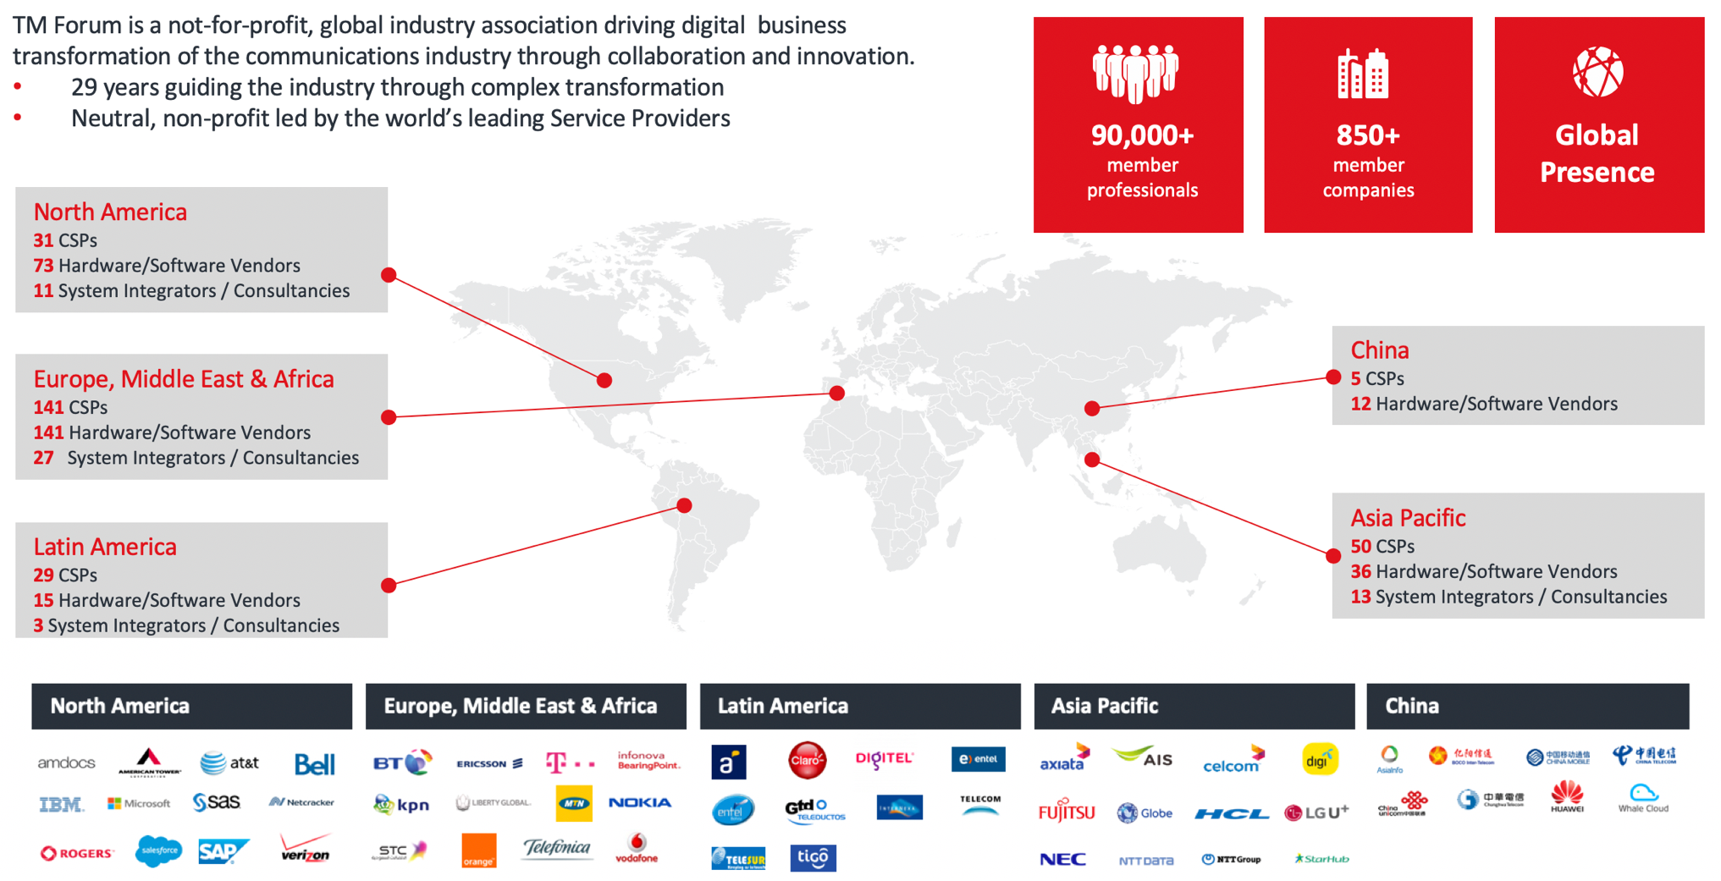
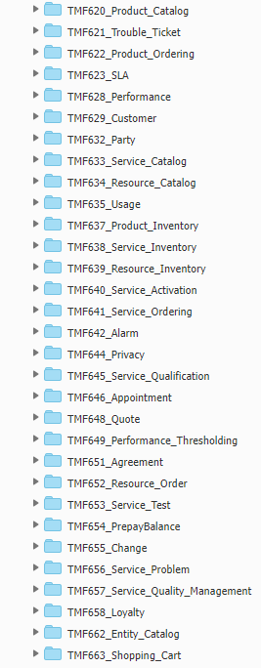
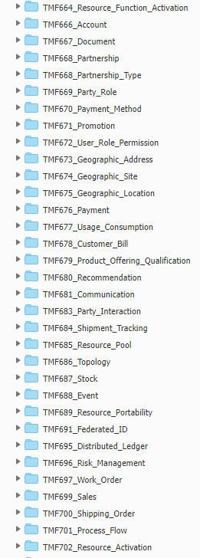
TMF API at a glance
+ 70 APIs defined
TM Forum has 20+ active liaisons with other SDOS (3GPP, ETSI, MEF, etc..)
Forum Liaison Program | TM Forum

Slide 4
TMF Open APIs benefits for Camara
based on industry standards and Telco companies’ best practices with large adoption in the industry
get a consistent information model to start our design work & part of an API ecosystem meaning that each API will be consistent and compliant with connected API (integration BSS/OSS)
provide a complete API ecosystem (event API, API data model, tooling, conformance, etc…) defined in a guideline document (TMF630)
technical assets are available under Apache 2.0 license
aligned with sounds restful API principles – we expect API to be
flexible API (An API is not specialized for a service or resource type but allow a large scope of usage; Several UC could be managed within one API – eg: Ordering API could manage: New start, Changes, Cancels, Life-cycle Status UC)
extensible API (extension pattern to add additional attributes, polymorphism to specialize them ) to extend with non-TMF attributes but also rationalize API resource model to keep it easy-to-use (addition by subtraction)
Notes:
To share vocabulary across domains
→ align resource name on SID vocabulary
To standardize similar services provided by applications of the same functional block
→ align Web Service signature on TMF templates

Slide 5
TMF API candidates for Camara family

Slide 6

TMF API candidates for Camara family
Quality On Demand | It provides the customer with the ability to: set quality for a mobile connection (e.g., required latency, jitter, bit rate). get notification if network cannot fulfill. NOTE: The scope of this API family should be limited (at least at a first stage) to 4G and 5G.
TMF640 Service Activation & Configuration TMF702 Resource Activation & Configuration | TMF640 & TMF702 allow to perform operations on the service and resource themselves. TMF allow to specialize this API resources. These 2 APIs provided a set of event + monitor pattern for async operation completion. (see examples in this deck in next section)

Slide 7
TMF API candidates for Camara family
Edge Discovery | It provides the customer with the ability to: Discover the set of edge nodes available in a certain region, where the customer can deploy edge applications discover the set of edge nodes in a certain region where a certain API functionality is available (and thus the customer edge application can make use of it). NOTE: Applicable at provisioning time. Note that there can be a mode in which the customer does not know about the actual edge nodes and can just ask for the deployment of an edge app to cover a certain region (the provider decides which edge nodes will be needed). request the edge service instance to connect to for a certain user/device, based on its location and app requirements. This includes edge application discovery (mandatory) and edge application relocation (optional, in mobility scenarios for service contuinity support).
TMF639 resource Inventory TMF633 Service Catalog TMF640 Service Activation & Configuration TMF 638 Service Inventory TMF642 Alarm Management TMF641 Service ordering management TMF675 Geographic Location | TMF Catalyst The Edge in Automation provided an API component description in support of a set of Operational Domains exposing and managing “Network” Services. These services are referred to as Edge Computing as a Service (ECaaS) and include all services offered from a service provider including connectivity, end points, etc. An Operational Domain supports a set of functions and capabilities responsible for the complete lifecycle of services and resources within its domain, including exposure of services supported by SLAs, interfacing via standard TMF APIs with the OSS systems and other operational domains.

Slide 8
TMF API candidates for Camara family
Connectivity Service management & monitoring | Order Connectivity Services with a specific SLA (min throughput, max latency, min availability etc) • Manage SLAs (read, update)
TMF623 SLA | TMF 623 API resources managed: ServiceLevelAgreementSpecification: To define a definition of an SLA (design) ServiceLevelAgreement : To instantiate an SLA to one or several instance of service (runtime) ServiceLevelAgreementViolation : To log an SLA violation (linked to a ServiceLevelAgreement) + events managed for these resources

Slide 9
TMF API candidates for Camara family
Connectivity Service management & monitoring | • It provides the customer with the ability to consume customer related data (e.g., SLA, subscriber data, customer profile), • It provides the customer with the ability to consume operation related data (e.g. PM/FM data, logs, trace, analytics reports, event notifications). NOTE 1: The management data feeds customer owned systems, and can be used for internal consumption (B2B) or made available to their own customers (B2B2X, e.g. hyperscaler enriches management data with additional information and exposes them to their own customers via proprietary APIs). • It provides the customer with the ability to gain access to Customer-Facing Service (CFS) catalog and inventory. NOTE 2: This includes catalog of APIs and inventory of edge nodes (features, location, availability)
TMF632 Party TMF629 Customer | Related to customer data, these 2 TMF API allow to manage party (individual or organization) end party role as Customer.
TMF633 Service Catalog TMF 638 Service Inventory TMF634 Resource Catalog TMF639 Resource inventory | TMF633 manages the service specification → the catalogue description of the service while TMF638 exposes the service instances in the inventory. These API could be completed with Resource level API to retrieve and consult all supporting resource. The service is managed with state and in relationship with place (location) Additional API at service level like TMF640 Service Activation & configuration could be also useful.

Slide 10
TMF API candidates for Camara family
Geofencing | Define a geographical area or path on which a device/devices are allowed to operate Manage rules for action at violation
TMF675 Geographic location TMF723 Policy API TMF639 Resource Inventory | Resource GeographicLocation… The API is aligned with GeoJson and allow to manage point, multiPoint, line, multiline & polygon Device are managed as resource and are related with place (GeographicLocation is a place subtype) TMF723 Policy API is used to describe policy rule (design). Based on Action-Event-Confition this API will be introduced S1-2022. In Resource inventory (TMF639), it is possible to associate a set a ‘location’ with role (leveraging TMF675). To be check: Policy rule could be associated to resource location change event.

Slide 11
TMF API candidates for Camara family
Device Status | Retrieve information about an individual device or groups of devices, e g Reachability status Roaming status Network used Geographical position IP address IMSI-Device relation Abnormal behavior NOTE 1: The customer can explicitly query for this information (request-response mode) or be reported with notifications on subscribed events (subscribe-notify mode). NOTE 2: Examples of this info include e.g., location tracking (UE location and cell site), USIM change, no. devices present in an area (RA, TA, cell), device mobility info (intra-TA handover, inter-TA handover), CN type change (5G to 4G, vice versa), roaming status, device reachability (e.g. for SMS delivery). NOTE 3: Device status is limited to information available in the communication network and especially does NOT include device specific information about firmware, software, battery state etc
TMF639 resource Inventory TMF702 resource activation & configuration TMF688 Event | A device is managed as a physical resource. 2 APIs could be considered to retrieve the device information: TMF639 to access an inventory of the device representation (a database) or TMF702 to directly access to the device itself. Resource location, status & characteristic will allow to manage this information. These API triggers event directly, and all event could manage with TMF688

Slide 12
TMF API candidates for Camara family
Network status | It provides the customer with the ability to receive information about network status. NOTE 1: The customer can explicitly query for this information (request-response mode) or be reported with notifications on subscribed events (subscribe-notify mode). NOTE 2: Examples of this network info include performance measurements (e.g., UL/throughput, latency, jitter, packet loss rate, etc.), fault events (e.g., network congestions, node failure). NOTE 3: Performance measurements and fault events can be provided at network node (function)level (e.g., disturbances) , network domain (slice subnet, private network) or end-to-end (slice) level.
TMF623 SLA TMF628 Performance TMF656 Service Problem | See above for TMF623. TMF628 allow to define performance indicator specification (and group of them) and then to manage on demand performance collection capture or measurement job (for recurring indicator collection). Resources managed in TMF628: PerformanceIndicatorSpecification, PerformanceIndicatorGroupSpecification, MeasurementCollectionJob, OnDemandCollection, Stream, TrackingRecord + events for all of them TMF656 Service Problem could also be used to trigger service issue like network congestion. Resources managed in TMF656: ServiceProblem, ProblemGroup, ProblemUngroup, ProblemAcknowledgement, ProblemUnacknowledgement+ events for all of them

Slide 13
TMF API candidates for Camara family
Traffic influence | It provides the customer with the ability to modify the connection policies of UEs and applications in terms of how the traffic flows NOTE 1: wrt routing, the customer can specify the edge node towards which traffic shall be routed.
TMF702 resource activation & configuration TMF723 policy TMF7xx policy execution | TMF702 API allows to change resource configuration directly on the resource itself. Newly introduced TMF723 (not yet released) allows to define policy rule (design). This policies could be associated to any entity of the model. Additionally, a new API will be introduced to manage “execution” of policy rule. This API could be use in conjunction with TMF640 to check or to perform user configuration change.

Slide 14
TMF API candidates for Camara family
Accounting, Charging and Billing | It provides the customer with the ability to: get information about the usage of the services and components that can be charged for (e.g. changes for QoS during each session lifetime) get information about actual cost for API usage NOTE: This could be transversal to the functional (service) APIs and apply to all of them.
TMF635 Usage TMF678 Customer bill | TMF632 manage definition of usage (usage specification) an instance for usage. This usage could be rated and then associated to a product. An evolution with TMF project is to introduce a service usage. On rated usage could be ‘collected’ and aggregated in AppliedCustomerBillingRate (from TMF648) on order to be bill (within a customer bill).

Slide 15
illustrate TMF extension/ polymorphism

Slide 16
illustrate TMF extension/ polymorphism
TMF open API defined extension/polymorphic pattern to use their assets with flexibility
Most entities in TMForum are extensible. Meaning, they can be treated as a base class to a sdo/company-specific extension.
Being a “sort of” TMForum entity means that this extended or sub-classed entity can be passed in any relevant TMForum API.
The sub-classed entity can still confirm to all the mandatory requirements of its base-class, while adding new attributes and relationships.
The inheritance structure is available if you need it, but there is no obligation to implement unnecessary attributes or relationships.
The consumer of the API is made aware of the sub-class using the @type attribute or can explicitly request this class as a filter.
notes:
In a context of an Orange Project (pikeo) we have already blended 3gpp service model with TMF API
MEF already use TMF API and encapsulate MEF service description (service payload vs envelope)

Slide 17
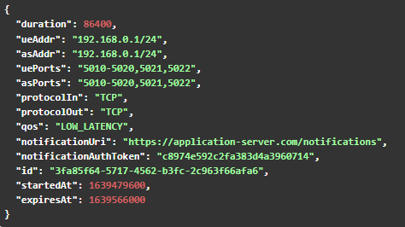
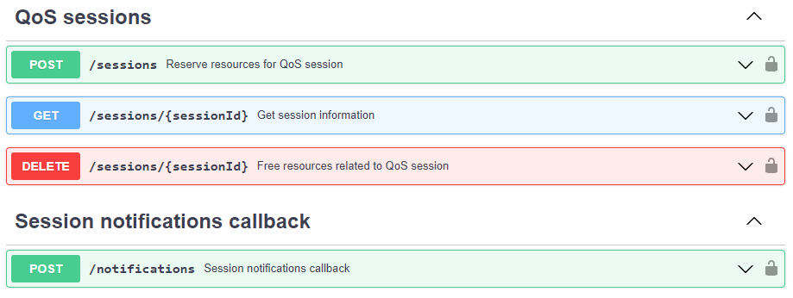
illustrate TMF extension/ polymorphism
Consider Camara QualityOnDemand API (QualityOnDemand/code/API_definitions at main · camaraproject/QualityOnDemand (github.com)) as a sample
Identify TMF API → here TMF702 Resource Activation & Configuration
Use this to illustrate Open TMF API extension/ polymorphism patterns

Slide 18
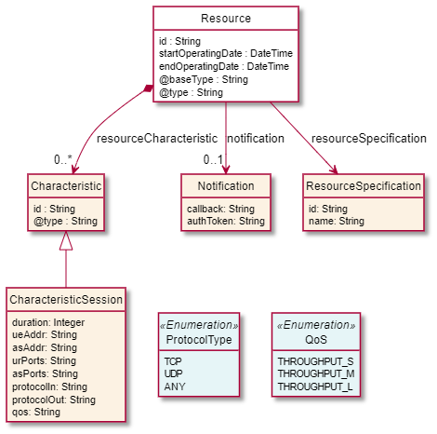
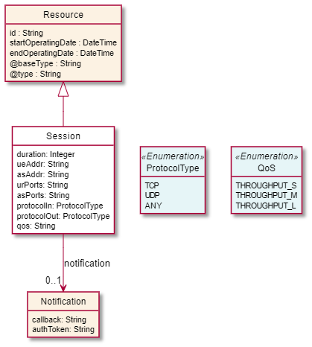

illustrate TMF extension/ polymorphism
This examples are for illustration purposes and not design recommendation

Slide 19
Next steps ?

Slide 20
next steps?
back to the initial question: Do the Open TMF API are appropriate in Camara context ?
feedback from this team?
assess TMF API within workgroup Backlog APIs?
go in more details to identify where it makes sense?
prioritize
use case study
bilateral review with Camara API stakeholder
swagger sample
collaborate with TMF?
get official TMF contribution
liaison
use of tooling & produce resource model

Slide 21
Thanks

